Slide 1
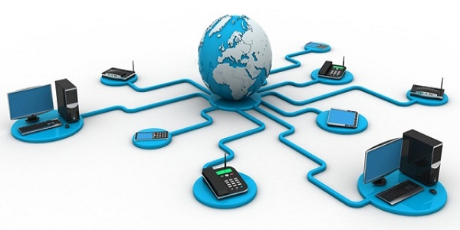
Introduction To Web Technologies
Open source web development
Eng. Mohamed Mustafa Aboaly

Slide 2
Agenda
Introduction about computers.
What is internet?
How does your computer connect to the Internet?
What is the World Wide Web?
What is Website?
What is URL?
Addressing schemas

Slide 3
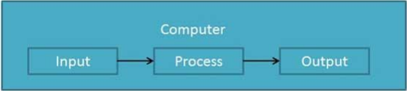
What is Computer ?
an electronic device which is capable of receiving information (data) in a particular form and of performing a sequence of operations in accordance with a predetermined but variable set of procedural instructions (program) to produce a result in the form of information or signals.

Slide 4
Computer Classification
Computers can be generally classified by size and power as follows, though there is considerable overlap:
Personal computer: a small, single-user computer based on a microprocessor. In addition to the microprocessor, a personal computer has a keyboard for entering data, a monitor for displaying information, and a storage device for saving data.
Workstation: a powerful, single-user computer. A workstation is like a personal computer, but it has a more powerful microprocessor and a higher-quality monitor.
Minicomputer: a multi-user computer capable of supporting from 10 to hundreds of users simultaneously.
Mainframe: a powerful multi-user computer capable of supporting many hundreds or thousands of users simultaneously.
Supercomputer: an extremely fast computer that can perform hundreds of millions of instructions per second.

Slide 5
Computer architecture.
Computer
Hardware
Any physical touchy Components
Software
Any logical untouched Components

Slide 6
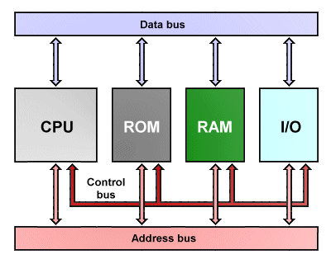
How Computer Works ?

Slide 7
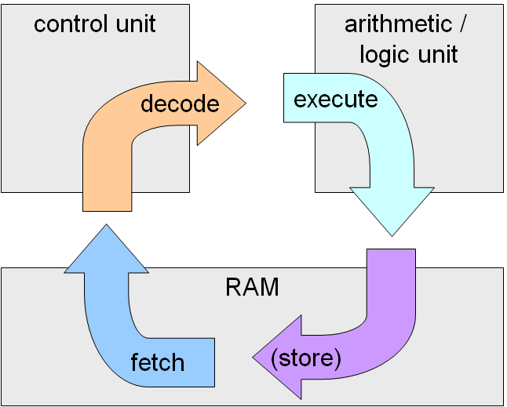
Data representation and Storage.
Computer only talks binary ( 0 and 1).
Any data in or out must be represented in binary form (Stream of zeros and ones 10100101010000111101010)

Slide 8
Execution cycle
Each computer's CPU can have different cycles based on different instruction sets, but will be similar to the following cycle:
Fetching the instruction: The next instruction is fetched from the memory address that is currently stored in the program counter (PC), and stored in the instruction register (IR). At the end of the fetch operation, the PC points to the next instruction that will be read at the next cycle.
Decode the instruction: During this cycle the encoded instruction present in the IR (instruction register) is interpreted by the decoder.
Read the effective address: In case of a memory instruction (direct or indirect) the execution phase will be in the next clock pulse. If the instruction has an indirect address, the effective address is read from main memory, and any required data is fetched from main memory to be processed and then placed into data registers If the instruction is direct, nothing is done at this clock pulse. If this is an I/O instruction or a Register instruction, the operation is performed (executed) at clock Pulse.
Execute the instruction: The control unit of the CPU passes the decoded information as a sequence of control signals to the relevant function units of the CPU to perform the actions required by the instruction such as reading values from registers, passing them to the ALU to perform mathematical and writing the result back to a register.

Slide 9
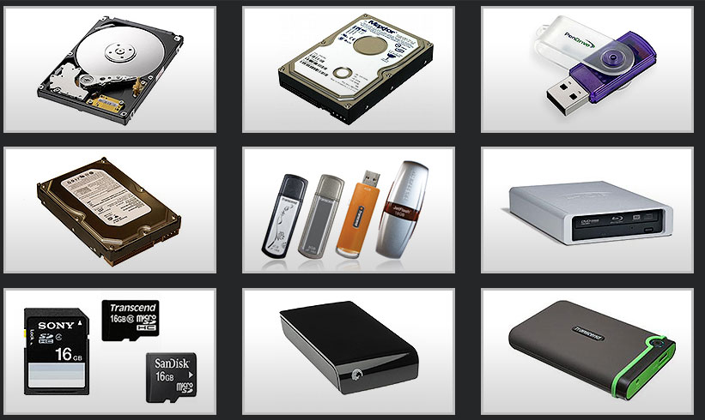
Data storage devices
Data must be stored in permanent devices
Floppy disks , zip drives , optical disks , flash disks and hard disks are often used for storing data.

Slide 10
Software architecture
Software
Operating system
Windows , mac , Linux and Unix.. etc.
Application programs
Office , calculator and image editing …etc.

Slide 11
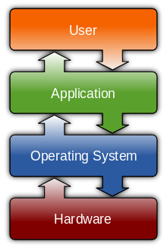
Operating system
An operating system (OS) is system software that manages computer hardware and software resources and provides common services for computer programs. The operating system is a component of the system software in a computer system. Application programs usually require an operating system to function.

Slide 12
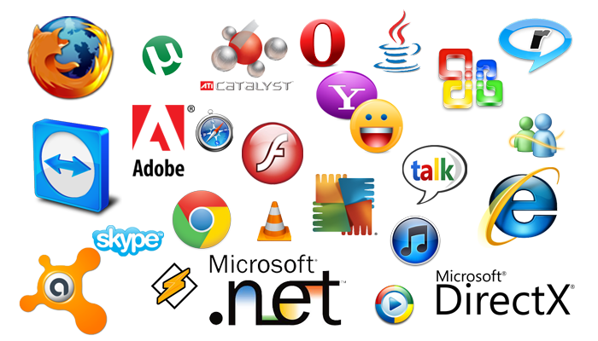
Application programs
Application software can be divided into two general classes: systems software and applications software. Applications software (also called end-user programs) include such things as database programs, word processors, Web browsers and spreadsheets.

Slide 13
Application types
Desktop
office
Media players
Web
Facebook
Twitter
Mobile
Apps run on mobile

Slide 14
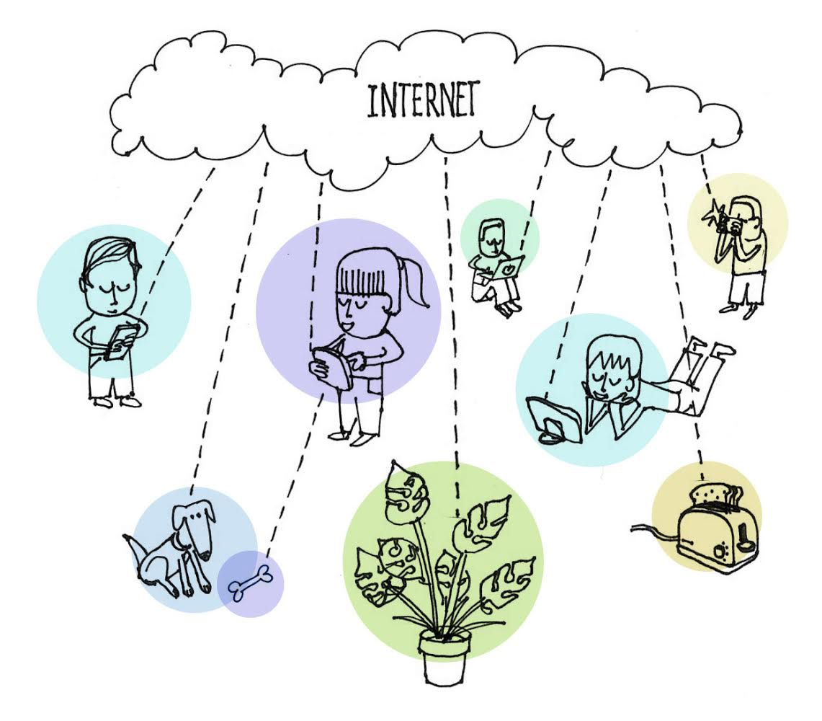
What is internet
The Internet, sometimes called simply "the Net," is a worldwide system of computer networks - a network of networks in which users at any one computer can, if they have permission, get information from any other computer (and sometimes talk directly to users at other computers).

Slide 15
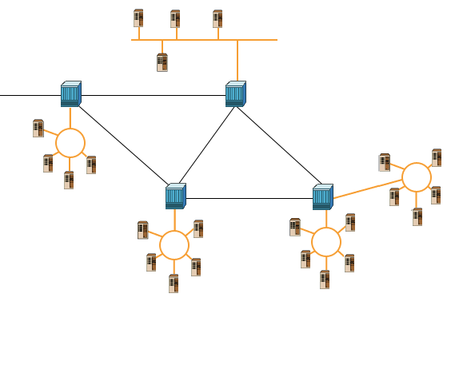
What is Internet ? Cont..
Millions of computer networks connected to each other via the ‘Internet Backbone’

Slide 16
What is Internet ? Cont..
The Internet Backbone:
The Internet Backbone is an infrastructure of fiber optics cable owned by private companies.

Slide 17
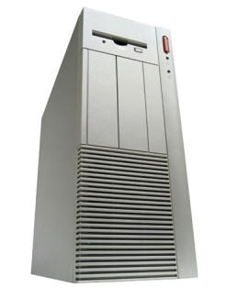
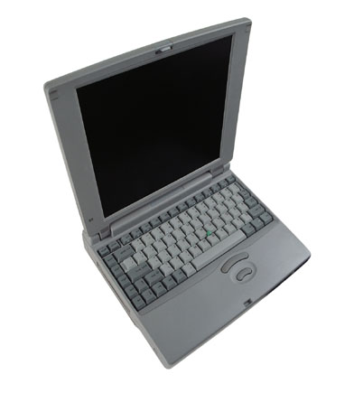
How does your computer connect to the Internet?
Internet
Service
Provider
Connects To Internet
Your computer
ISP Server checks your user name and password and assigns your computer an IP address
(“Authentication”)
Notes:
An Internet service provider (ISP), also sometimes referred to as an Internet access provider (IAP), is a company that offers its customers access to the Internet. The ISP connects to its customers using a data transmission technology appropriate for delivering Internet Protocol datagrams, such as dial-up, DSL, cable modem, wireless or dedicated high-speed interconnects.

Slide 18
What is the World Wide Web?
The World Wide Web (Web):
Is a network of information resources ( or collection of websites).
The Web relies on three mechanisms to make these resources readily available to the widest possible audience:
A uniform naming scheme for locating resources on the Web (e.g., URL).
Protocols: for access to named resources over the Web (e.g., HTTP).
Hypertext: for easy navigation among resources (e.g., HTML).

Slide 19
What is the World Wide Web? (Cont.)
Hypertext:
Is text displayed on a computer with references (Hyperlinks) to other text that the reader can immediately access, usually by a mouse click. Hypertext may contain tables, images, videos and other resources. The most extensive example of hypertext today is the World Wide Web.
Hyperlink (or link):
Is a reference to a document or a resource on the web.

Slide 20
What is Website?
Website:
A website is a collection of related and linked web pages via hyperlinks, images, videos or other digital assets that are addressed with a common domain name or IP address.
A web page is a document, typically written in Hypertext Markup Language (e.g. HTML).
All publicly accessible websites collectively constitute the World Wide Web.
The pages of a website can usually be accessed from (Home Page) which is web page has a simple Uniform Resource Locator (URL).
Notes:
Hypertext is text displayed on a computer with references (hyperlinks) to other text that the reader can immediately access, usually by a mouse click or keypress sequence. Apart from running text, hypertext may contain tables, images and other presentational devices. Other means of interaction may also be present, such as a bubble with text appearing when the mouse hovers over a particular area, a video clip starting, or a form to complete and submit. The most extensive example of hypertext today is the World Wide Web.
Hyperlink (or link) is a reference to a document or a resource on the web.
Domain Name: The name that identifies an Web site. For example: “google.com" is the domain name of Google's Web site.

Slide 21
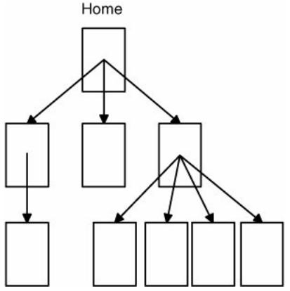
What is Website (Cont.)?

Slide 22
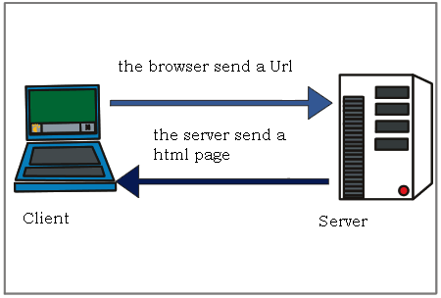
What is Website? (Cont.)
Client / Server architecture:

Slide 23
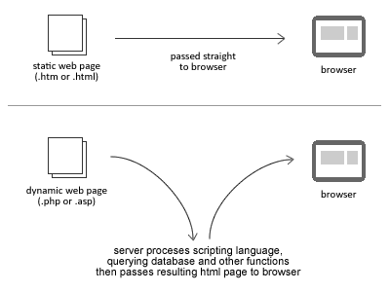
What is Website? (Cont.)
Static and dynamic web sites:

Slide 24

URL (Uniform Resource Locater):
URL (Uniform Resource Locater):
Unique address of a document or a resource on the internet.
You type a website address or “URL” into your browser.
Serves Data
Requests Data
http://www.Google.com
Client
Server

Slide 25
What is URL? (Cont.)
URL Have two parts:
Domain Name
http://www.Google.com
Protocol Type
HTTP = Hyper Text Transfer Protocol
FTP = File Transfer Protocol
A “Protocol’ is a structured set of communication rules that allows machines to share data.

Slide 26
What is URL? (Cont.)
Domain Name:
The name that identifies an Web site. For example: “google.com" is the domain name of Google's Web site.
To register a domain name internationally, you must buy it from ICANN or ICANN-Accredited Registrars.
Because the Internet is based on IP addresses, not domain names, every Web server requires a Domain Name System (DNS) server to translate domain names into IP addresses.

Slide 27
Addressing Schemes
Server Addresses
Uniquely identifies a specific computer. Ex.:131.107.1.240
Website Domain Name
Uniquely refers to a specific server address. Ex.: iti.net.eg
Website URL
Protocol + Domain name. Ex.: http:// www.iti.net.eg
Resource Addresses (Resource URL)
Example : http://www.iti.gov.eg/itiprofile/open-source.jpg
E-Mail Addresses
Must be unique. Example: maboaly@iti.net.eg

Slide 28
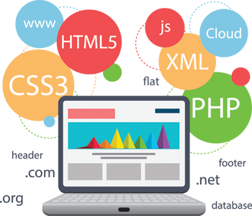
Web applications and design.
In computing, a web application or web app is a client-server software application in which the client (or user interface) runs in a web browser.

Slide 29
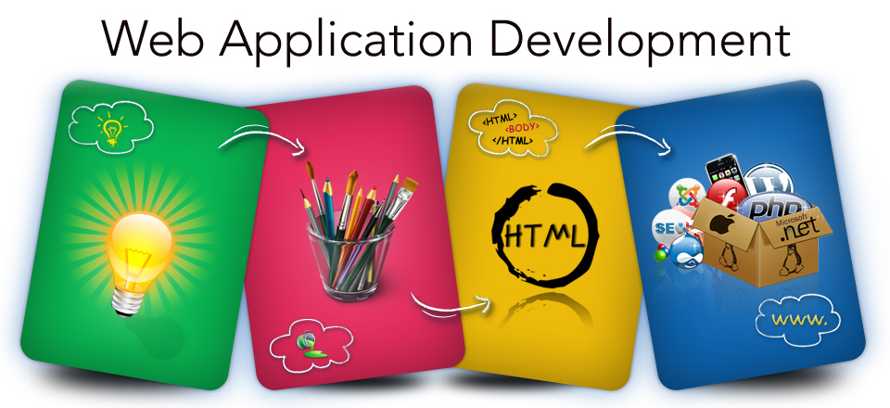
Web applications and design(cont...)

Slide 30

Thank you
Questions ?

